Slide 1
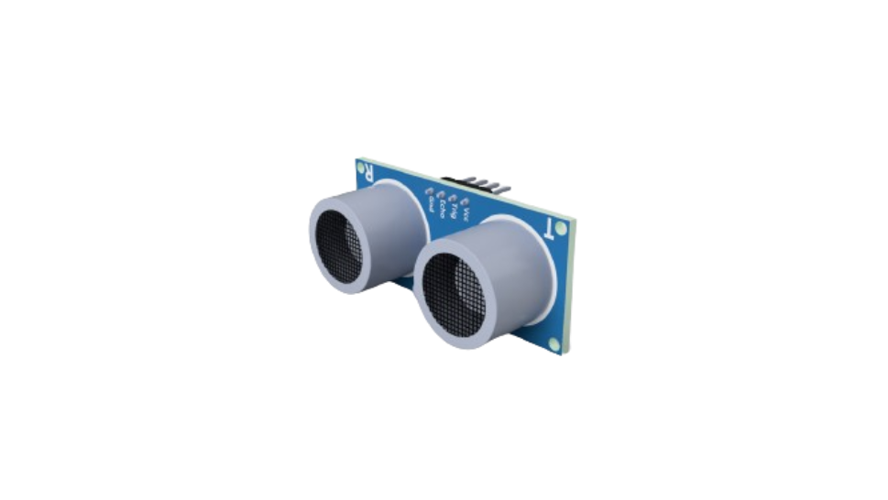
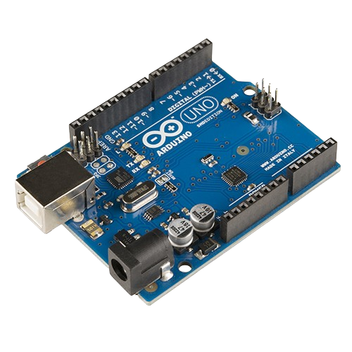
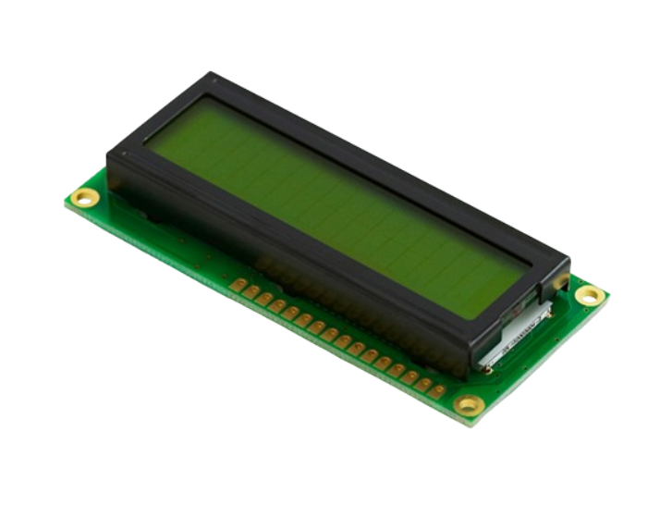



Arduino Course
Prepared by: Qossay Abu Rida
IEEE Robotics and Automation Society

Slide 2
Agenda
Embedded system
Arduino environment
Basic electronic component
ADC & DAC
Interrupts
Sensors
Actuators
Communication

Slide 3
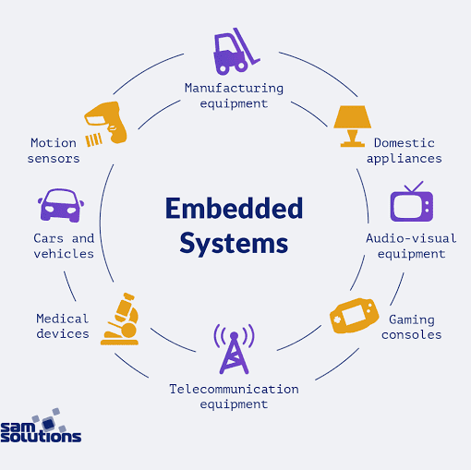
Embedded System

Slide 4
What is an Embedded System?
Definition: An embedded system is a specialized computer system that is designed to perform a specific task. Unlike general-purpose computers, which can run a variety of applications, embedded systems are dedicated to one or a few functions.
Common Use: Embedded systems are found in many everyday devices, from household appliances to automobiles, medical equipment, and industrial machines.

Slide 5
Basic Structure of an Embedded System
1- Microcontroller/Microprocessor:
The brain of the embedded system.
Executes programmed instructions to perform specific tasks.
Example: Arduino uses the ATmega328 microcontroller.
2- Memory:
RAM (Random Access Memory): Temporary storage for data and instructions currently in use.
ROM (Read-Only Memory): Permanent storage for the system's firmware and operating instructions.

Slide 6
3- Input Devices:
Collect data from the external environment.
Examples: Sensors, buttons, keyboards.
4- Output Devices:
Deliver data or actions to the external environment.
Examples: Displays, LEDs, motors.
5- Power Supply:
Provides the necessary power for the system to operate.
Can be battery-operated or connected to a power source.
6- Communication Interfaces:
Allow the system to communicate with other systems or devices.
Examples: Serial ports, USB, Wi-Fi, Bluetooth.

Slide 7
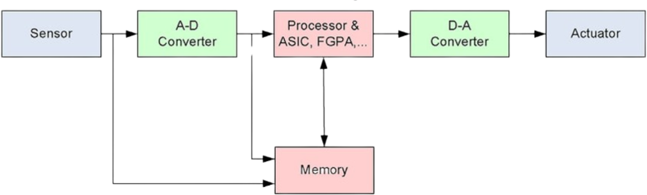
Basic Structure (Symbolic-Based)

Slide 8
Example of an Embedded System: Digital Thermometer
Microcontroller: Reads temperature data from the sensor and processes it.
Sensor: Measures the temperature and sends data to the microcontroller.
Display: Shows the temperature reading to the user.
Buttons: Allow users to switch between Celsius and Fahrenheit or reset the device.
Power Supply: Battery that powers the thermometer.

Slide 9
Arduino Environment

Slide 10
Arduino Hardware
Arduino Boards
Microcontroller-based boards with various input/output capabilities.
Examples: Arduino Uno, Arduino Mega, Arduino Nano.
Key Components
Microcontroller: The brain of the board (e.g., ATmega328 on Arduino Uno).
Digital Pins: Used for digital input/output (e.g., LEDs, buttons).
Analog Pins: Used for analog input (e.g., sensors).
Power Supply: Can be powered via USB or external power source.
Communication Ports: Serial, I2C, SPI for interfacing with other devices.

Slide 11
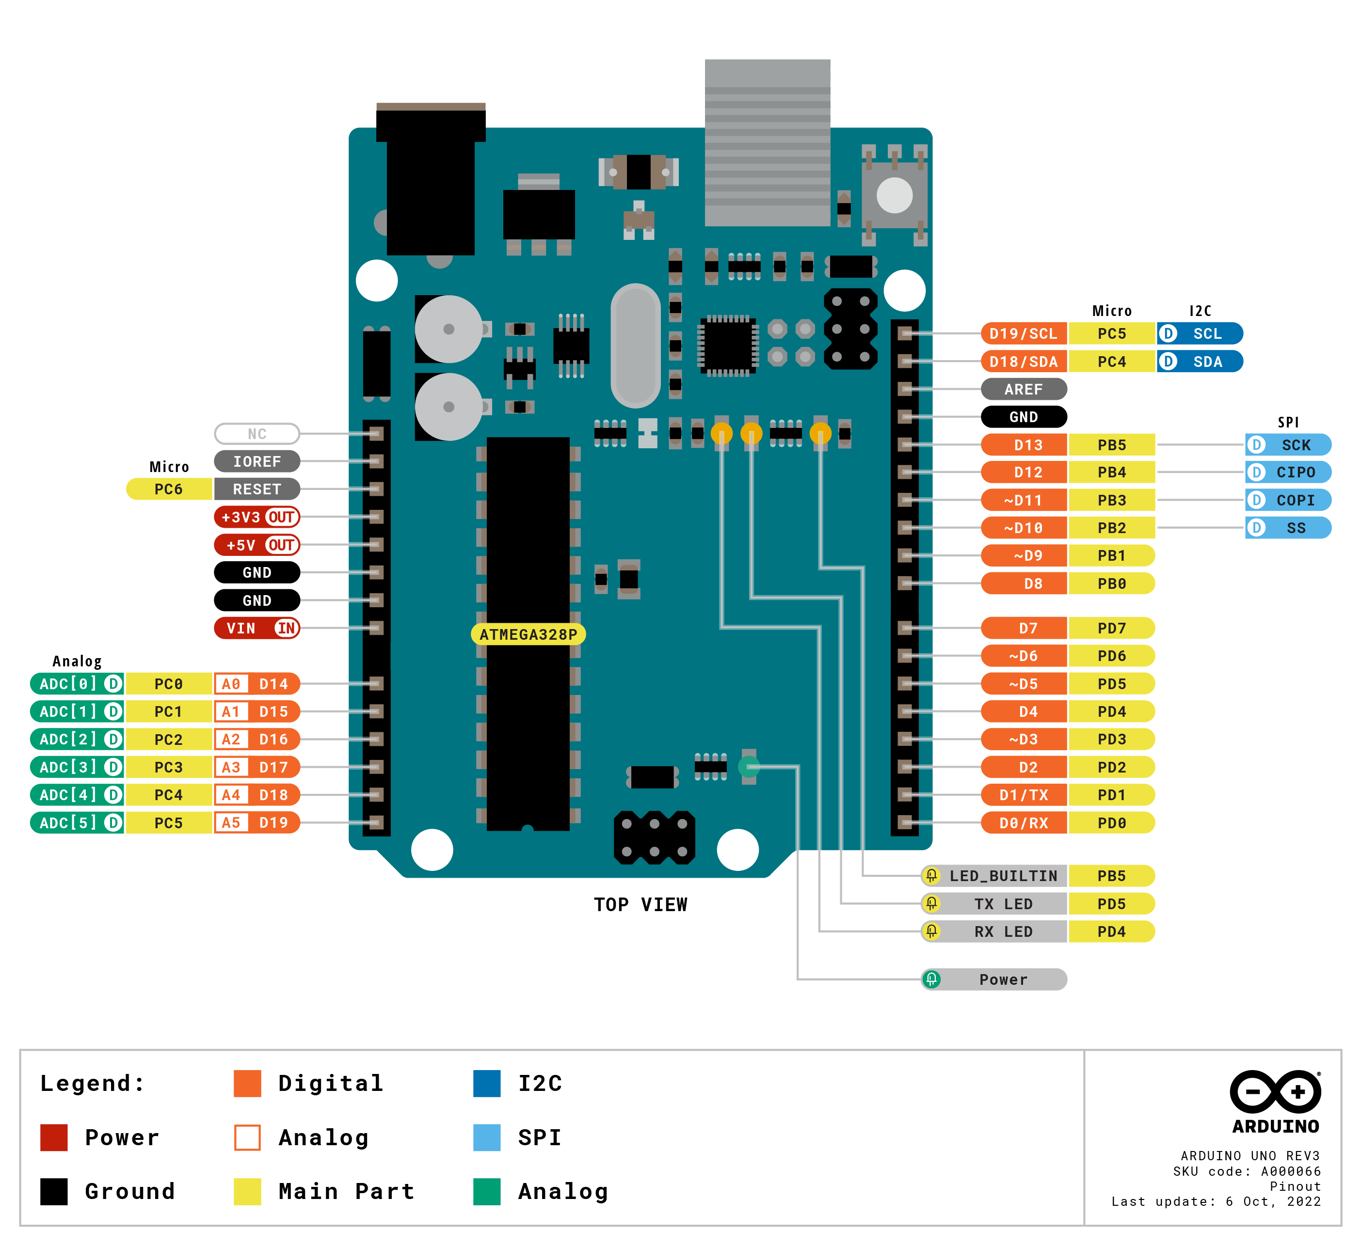
Arduino Uno board with labeled components.

Slide 12
Arduino Software (Arduino IDE)
Arduino IDE
Integrated Development Environment for writing, compiling, and uploading code to Arduino boards.
Available for Windows, Mac, and Linux.
Key Features
Code Editor: Write and edit Arduino sketches (programs).
Compiler: Convert sketches into machine code that the microcontroller can execute.
Uploader: Transfer the compiled code to the Arduino board via USB.
Serial Monitor: Communicate with the board and debug sketches using serial communication.
Programming Language
Based on C/C++ with simplified syntax and functions.
Uses libraries to add functionality (e.g., controlling motors, reading sensors).

Slide 13
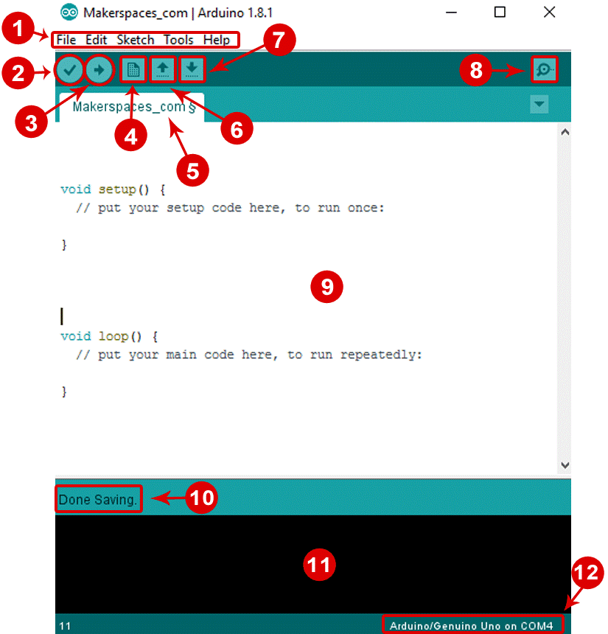
Arduino IDE simple sketch.

Slide 14

How to Download the Arduino IDE ?
Visit the Arduino Website:
Open your web browser and go to arduino.cc
Navigate to the Software Section:
Hover over "Software" in the main menu.
Click on "Downloads."
Choose Your Operating System:
Select the version for your OS (Windows, Mac, Linux).
Download the Installer:
Click "Just Download" if prompted for a donation.

Slide 15
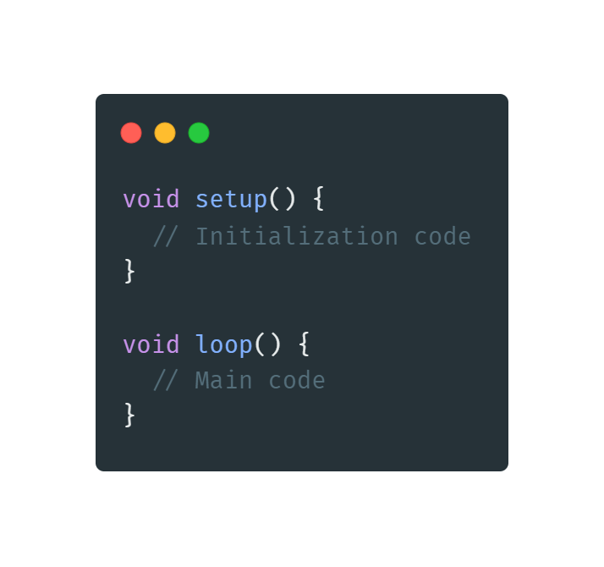
How to Program Arduino and Code Structure
Setup Function:
Purpose: Initializes settings.
Runs Once: This code runs once when the Arduino is powered on or reset.
Loop Function:
Purpose: Contains the main logic of the program.
Runs Repeatedly: This code runs in a loop after the setup function has completed.

Slide 16
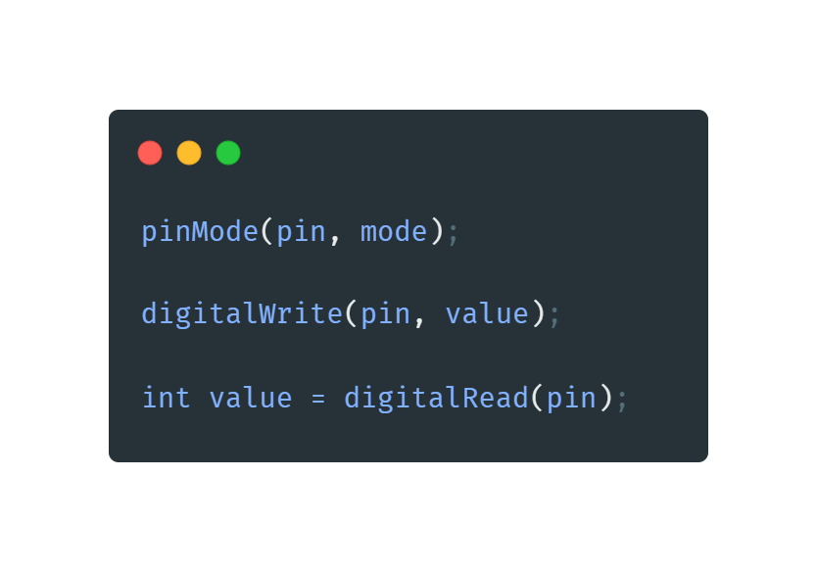
Common Functions Used in Arduino Programming
pinMode():
Purpose: Configures a specified pin to behave either as an input or an output.
digitalWrite():
Purpose: Sets a specified digital pin to HIGH or LOW.
digitalRead():
Purpose: Reads the value from a specified digital pin, either HIGH or LOW.

Slide 17
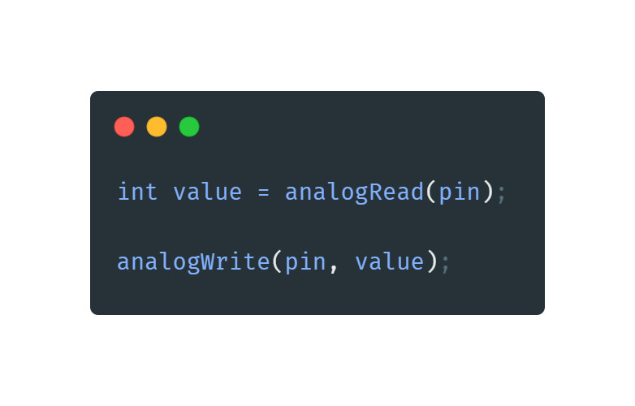
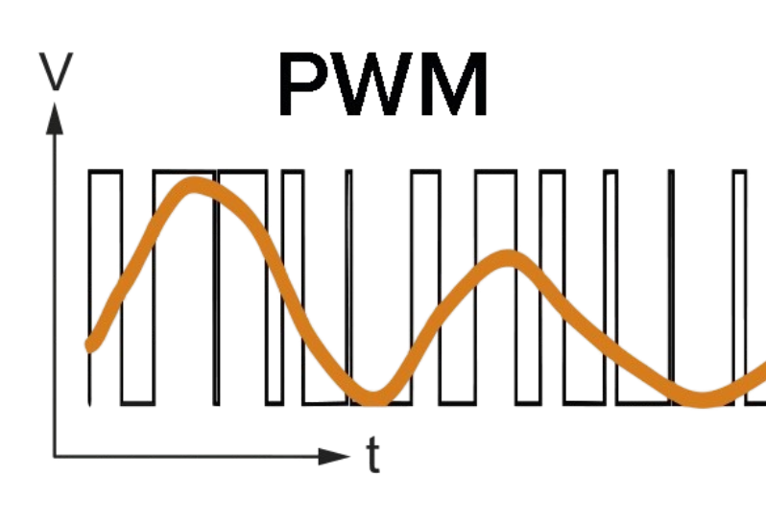
Common Functions Used in Arduino Programming
analogRead():
Purpose: Reads the value from a specified analog pin.
analogWrite():
Purpose: Writes an analog value (PWM wave) to a specified pin.

Slide 18
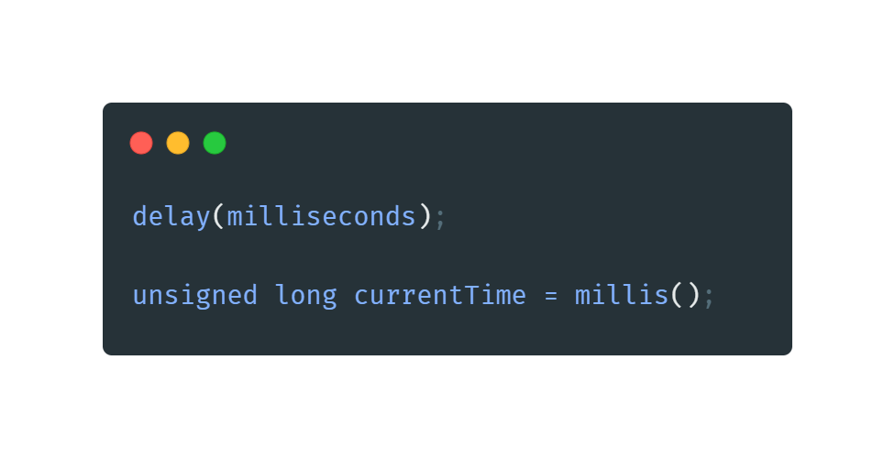
Common Functions Used in Arduino Programming
delay():
Purpose: Pauses the program for a specified number of milliseconds.
millis():
Purpose: Returns the number of milliseconds since the Arduino board began running the current program.

Slide 19
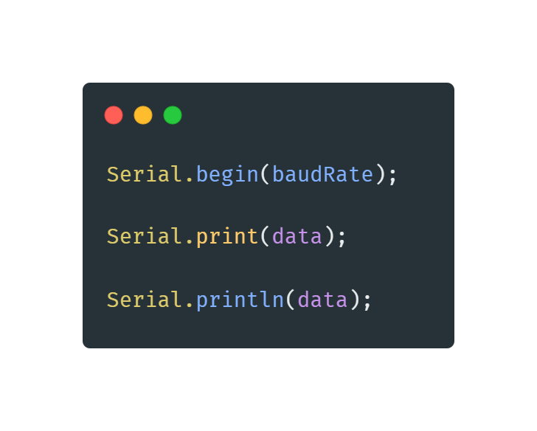
Common Functions Used in Arduino Programming
Serial.begin():
Purpose: Sets the data rate in bits per second (baud) for serial data transmission.
Serial.print():
Purpose: Prints data to the serial port as human-readable ASCII text.
Serial.println():
Purpose: Prints data to the serial port as human-readable ASCII text, followed by a carriage return character.

Slide 20
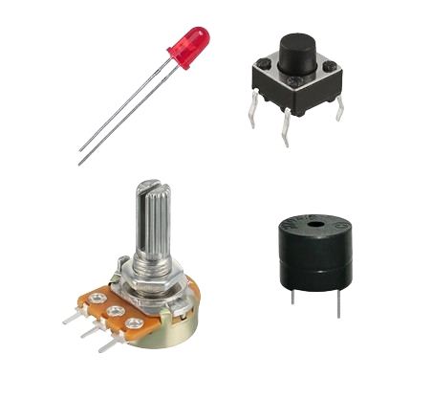
Basic Electronic Component

Slide 21
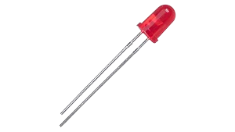
LED (Light Emitting Diode)
Definition: A semiconductor device that emits light when an electric current passes through it.
Usage: Visual indicators, status lights, displays.
Connection:
Anode (+): Connected to a positive voltage.
Cathode (-): Connected to ground, usually through a current-limiting resistor.

Slide 22
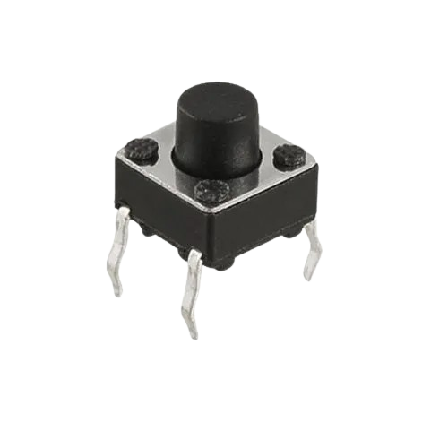
Button
Definition: A simple switch used to make or break a connection in an electric circuit.
Usage: User inputs, control signals, event triggers.
Connection:Typically connected between a digital input pin and ground or VCC.

Slide 23
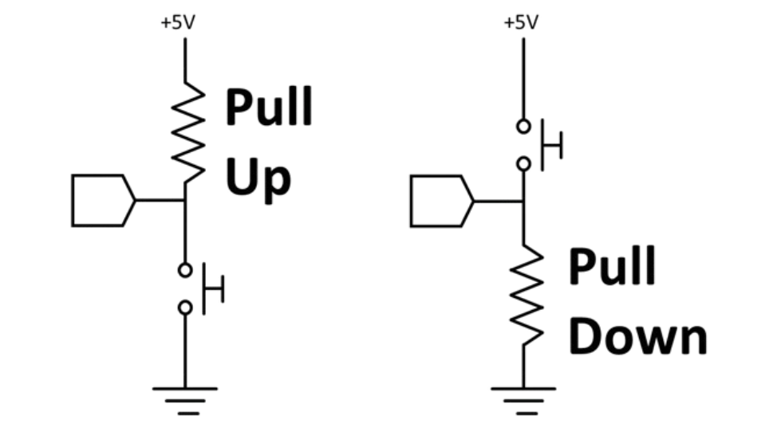
Pull-Up and Pull-Down Resistors:
Pull-Up: Connects the pin to VCC (high voltage) through a resistor, ensuring a known state when the button is not pressed.
Pull-Down: Connects the pin to ground (low voltage) through a resistor, ensuring a known state when the button is not pressed.
Internal Pull-Up: Use pinMode(pin, INPUT_PULLUP); to enable the internal pull-up resistor.

Slide 24
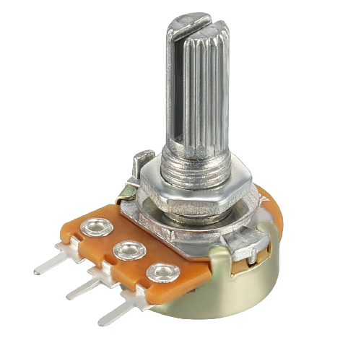
Potentiometer
Definition: A three-terminal resistor with a sliding or rotating contact that forms an adjustable voltage divider.
Usage: Variable resistors, volume controls, sensor calibration.
Connection:Wiper: Connected to an analog input pin.
Other Terminals: Connected to VCC and ground

Slide 25
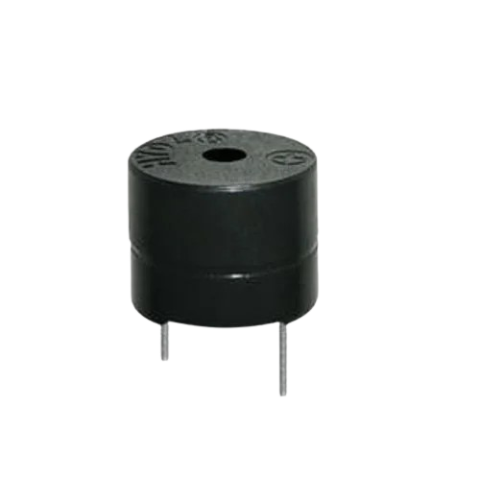
BUZZER (Sound Producing Device)
LED (Light Emitting Diode)
Definition: A device that converts electrical energy into audible sound when energized.
Usage: Audio alerts, alarms, timers, notifications.
Connection:
Anode (+): Connected to a positive voltage.
Cathode (-): Connected to ground, usually through a current-limiting resistor.

Slide 26
Examples for Basic Electronic Component

Slide 27

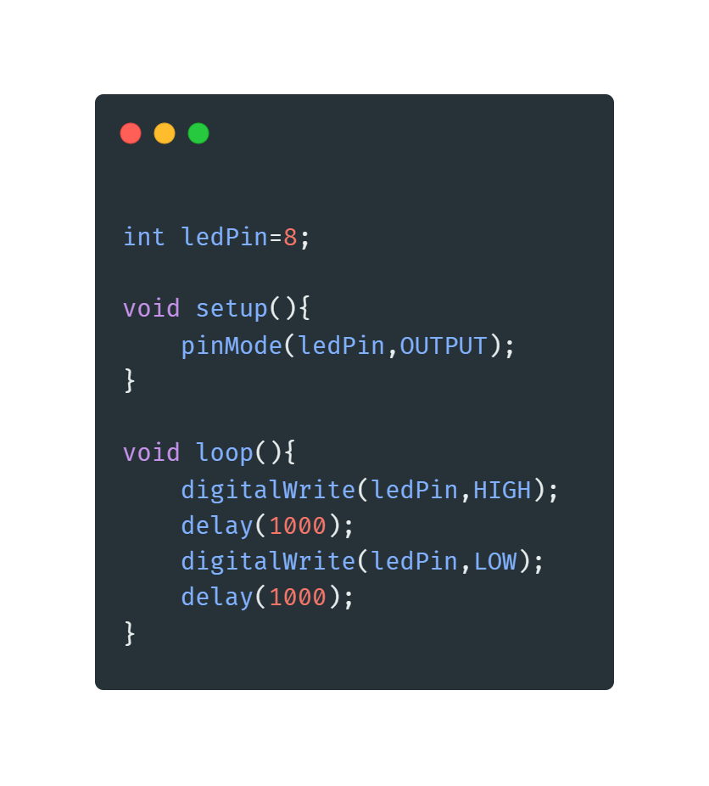
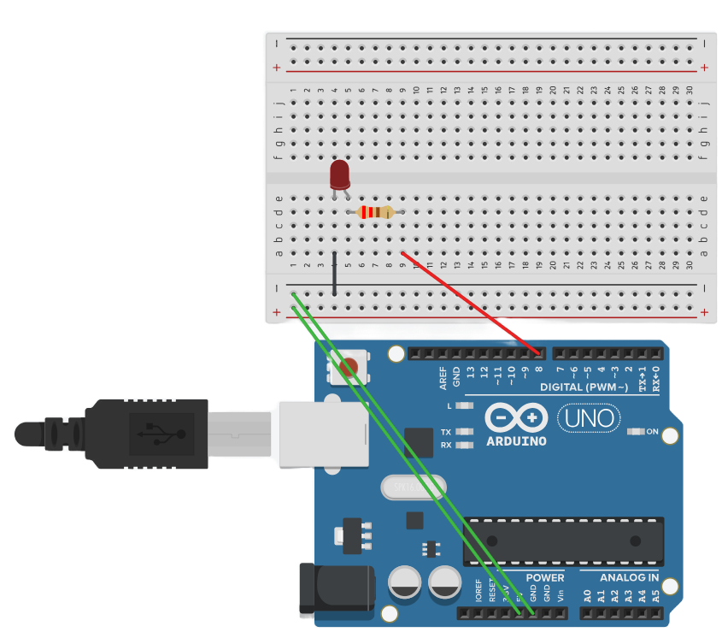
Example 1 => Blinking LED
Blinking LED using Delay function:

Slide 28
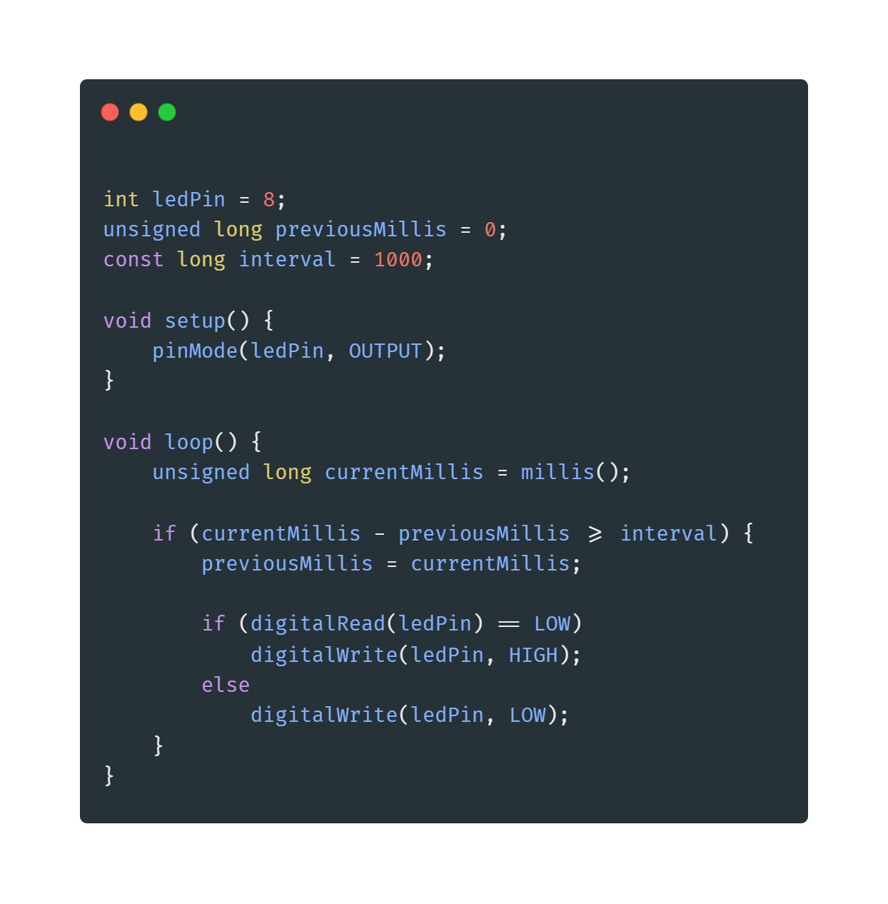
Example 2 => Blinking LED
Blinking LED using millis function:

Slide 29
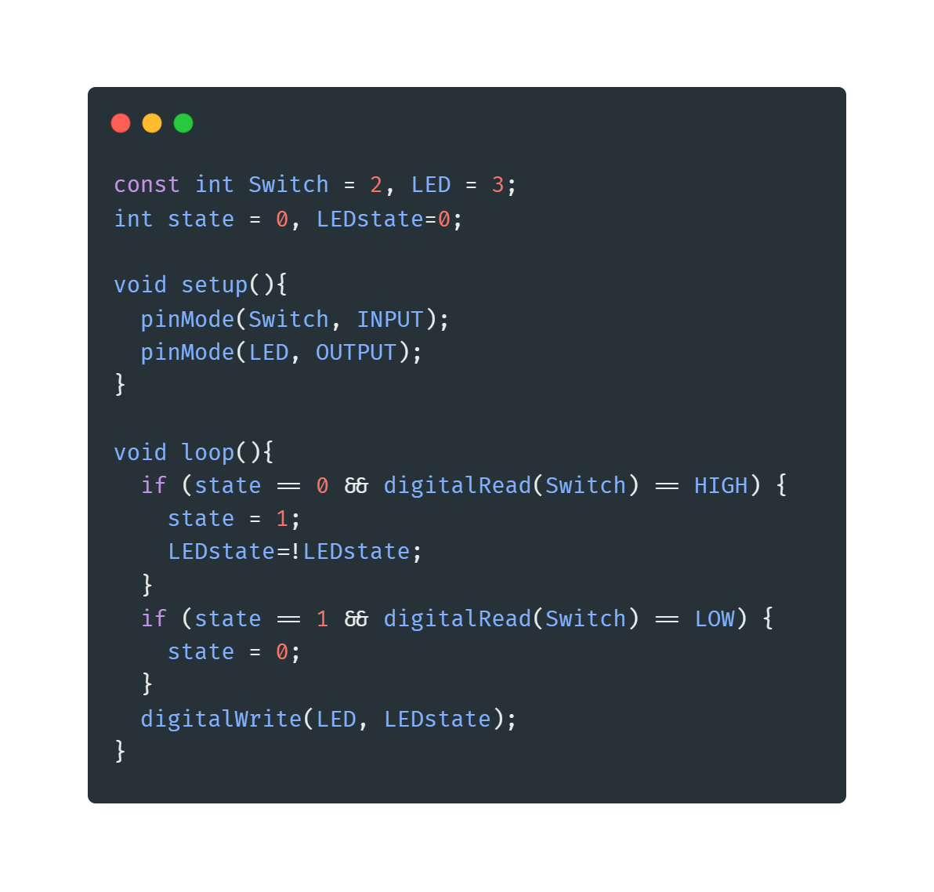
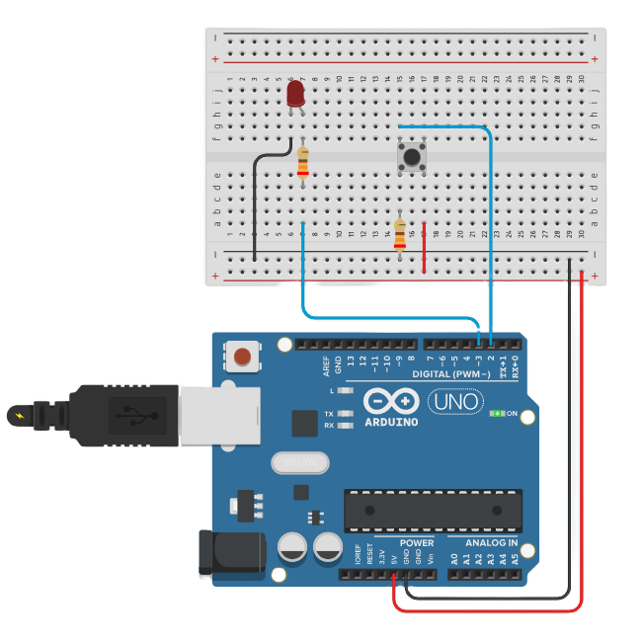
Example 3 => Toggle LED
Toggle LED without interrupts:

Slide 30
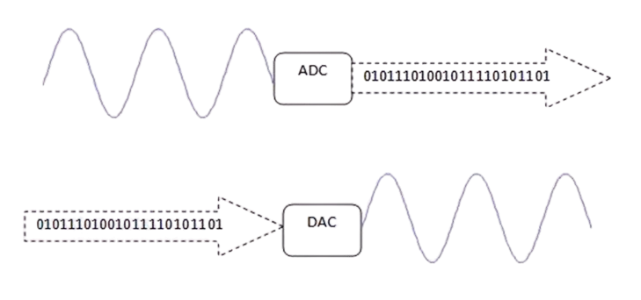
ADC & DAC

Slide 31
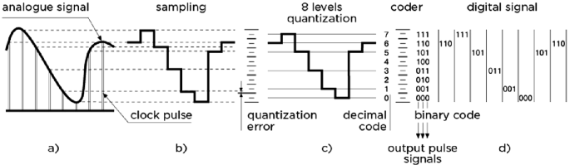
How ADC Works
Sampling: The analog signal is sampled at regular intervals.
Quantization: Each sample is approximated to the nearest value within a range.
Encoding: The quantized values are converted into binary code.

Slide 32
What is an ADC?
Definition: An Analog-to-Digital Converter (ADC) is a device that converts analog signals (continuous signals) into digital signals (discrete signals) that a microcontroller or computer can process.
Purpose: To allow digital systems to interact with the real world by converting analog inputs (e.g., temperature, sound, light) into a format they can understand and process.
What is a DAC?
Definition: A Digital-to-Analog Converter (DAC) is a device that converts digital signals (discrete signals) into analog signals (continuous signals).
Purpose: To allow digital systems to produce analog outputs (e.g., audio signals, light intensity control) that can be used in the real world.

Slide 33
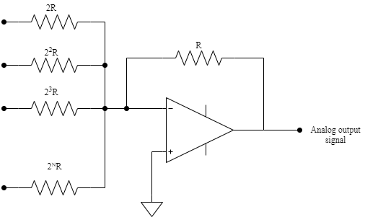
How DAC Works
Input: The digital signal is received from a microcontroller or computer.
Conversion: The digital values are converted to corresponding analog values.
Output: The analog signal is output to drive an analog device.

Slide 34
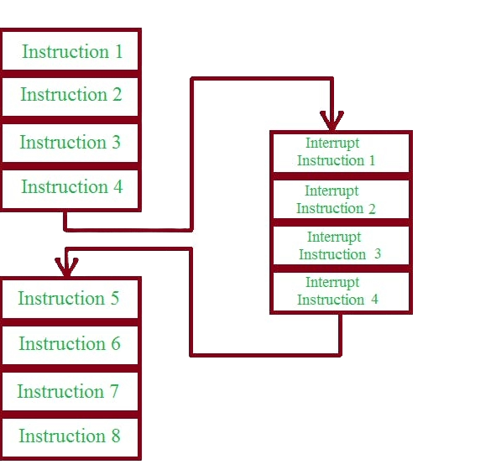

Interrupts

Slide 35
What are Interrupts?
Definition: Interrupts are signals that temporarily halt the main program execution to immediately run a special function called an Interrupt Service Routine (ISR).
Purpose: To handle time-critical tasks, respond to external events, or process real-time signals without delay.
Benefits: Allows for efficient handling of tasks without continuously checking for events within the main loop.

Slide 36
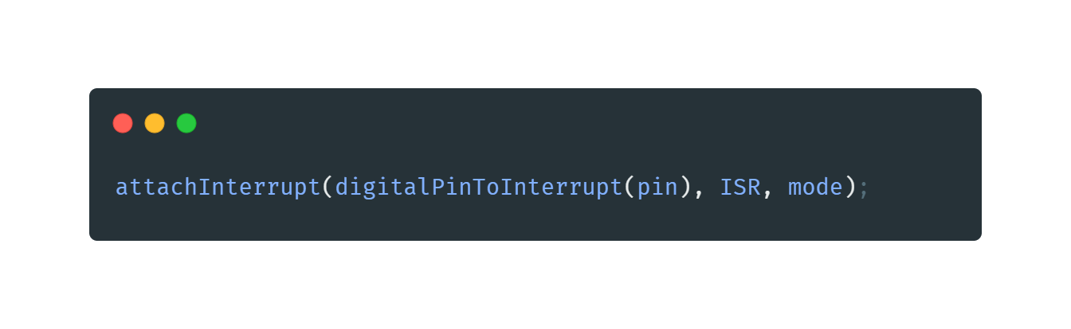
Using Interrupts in Arduino
Attaching an Interrupt:
Use the attachInterrupt() function to specify which pin and condition will trigger the interrupt, and which ISR to call.
Parameters:
pin: The pin number where the interrupt is attached.
ISR: The name of the function to call when the interrupt occurs.
mode: The condition that triggers the interrupt (LOW, CHANGE, RISING, FALLING).

Slide 37
Examples for ADC & Interrupts

Slide 38
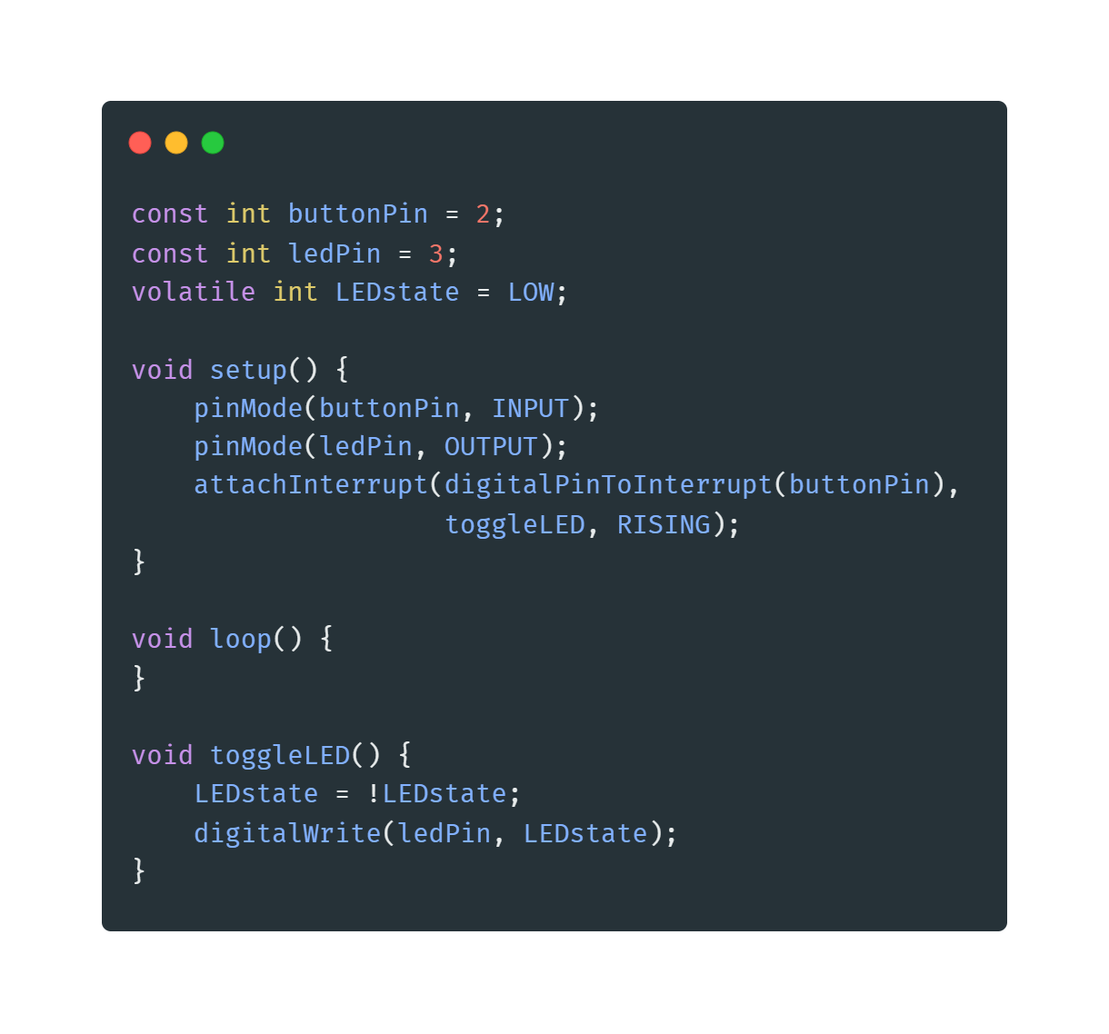
Example 4 => Toggle LED
Toggle LED with interrupts:

Slide 39
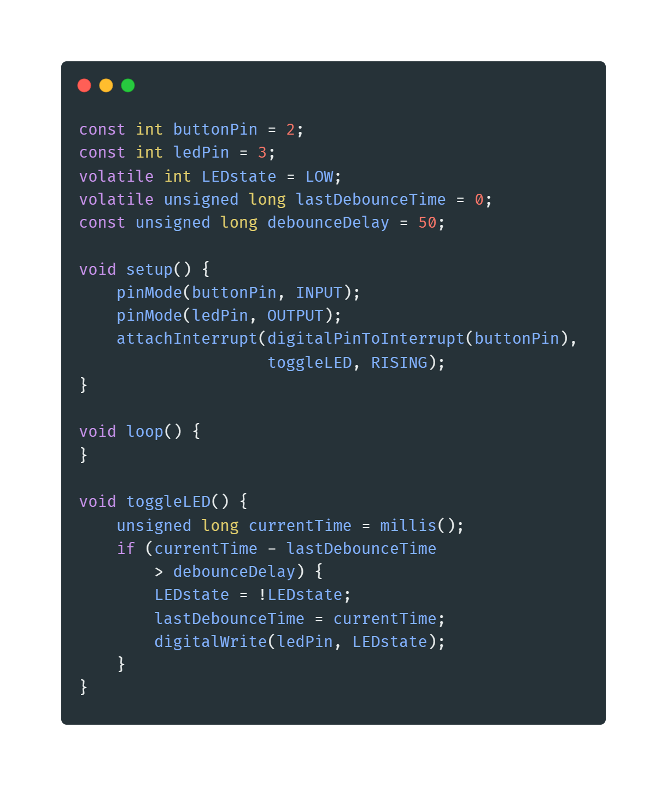
Example 5 => Toggle LED
Toggle LED with interrupts and avoid bouncing effect:

Slide 40
Example 6 => Controlling LED
Creating an interactive system using an Arduino that involves the following components:
Potentiometer
Button
LED
Requirements:
The potentiometer should control the brightness of the LED.
Button should toggle the LED on and off.
Use interrupts to handle the button presses efficiently.

Slide 41
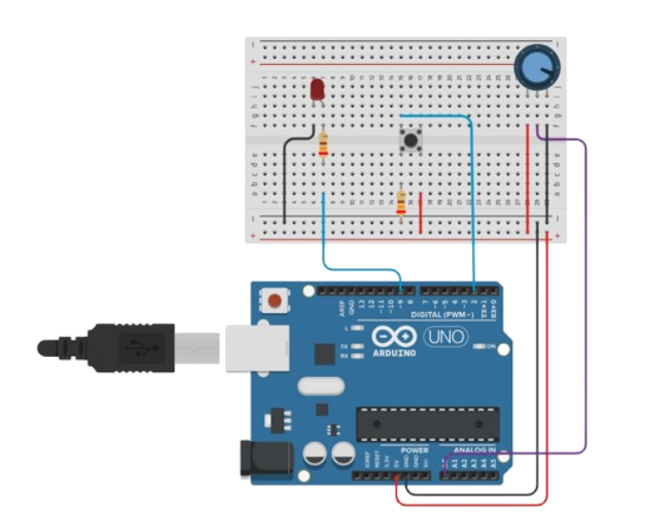
Example 6 => Controlling LED

Slide 42
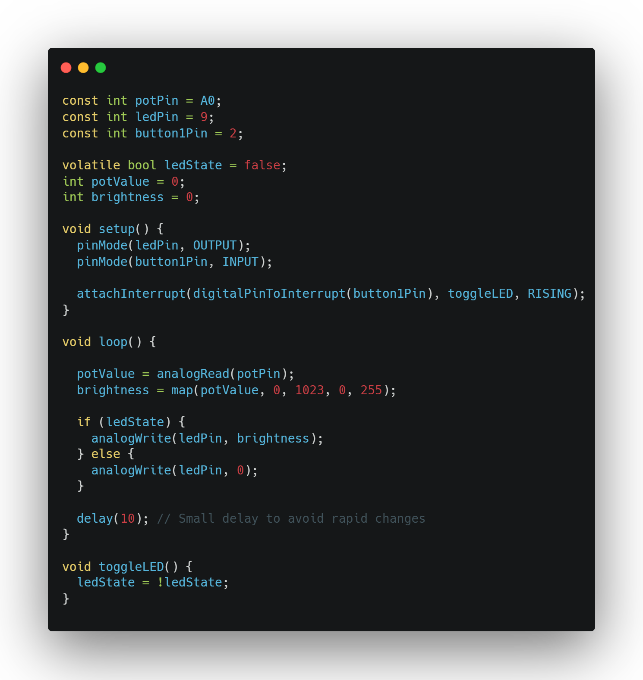
Example 6 => Controlling LED

Slide 43
Example 7 => Controlling Array of LEDs Unsolved example
You need to create an Arduino system that controls four LEDs based on the value of a potentiometer.
Requirements:Use a potentiometer to determine how many LEDs should be turned on.
The system should work as follows:
If the potentiometer value is between 0 and 255, turn on 1 LED.
If the potentiometer value is between 256 and 511, turn on 2 LEDs.
If the potentiometer value is between 512 and 767, turn on 3 LEDs.
If the potentiometer value is between 768 and 1023, turn on all 4 LEDs.

Slide 44
Example 8 => LED Reaction Game Unsolved example
Design an Arduino-based reaction game that uses LEDs, a potentiometer, and a button. The goal of the game is to test the player's reaction time.
Requirements:
Use a potentiometer to set the difficulty level of the game.
An LED should light up randomly after a delay.
The player must press a button as quickly as possible when the LED lights up.
The system should display the player's reaction time using LEDs.
The game should reset automatically after displaying the reaction time.

Slide 45
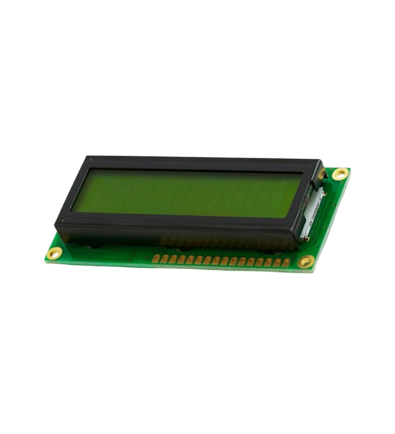
LCD liquid crystal display

Slide 46
Introduction to 16x2 LCD
Definition: A 16x2 LCD is a display module that can show 16 characters per line and there are 2 such lines.
Uses: Commonly used in various electronic projects for displaying data, such as temperature, humidity, sensor readings, etc.

Slide 47
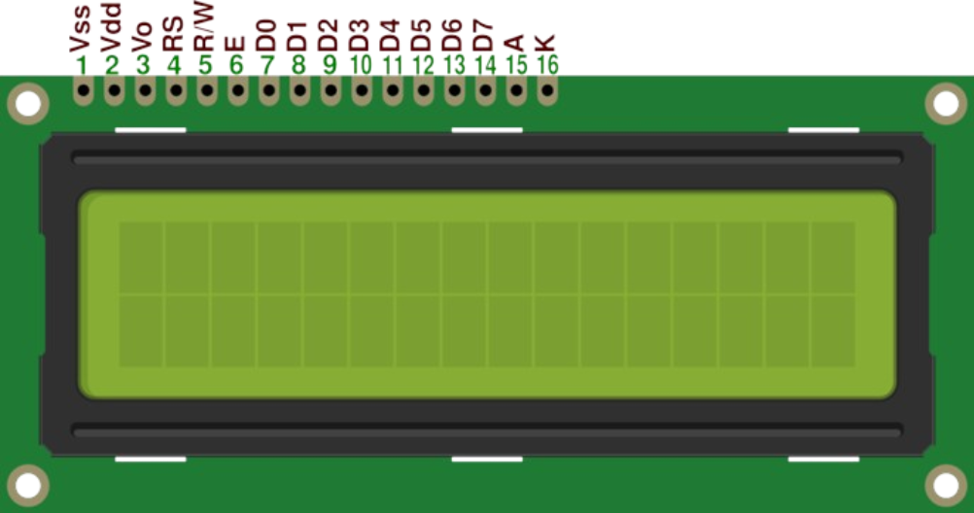
Pin Configuration
VSS: Ground
VDD: +5V Power Supply
VO: Contrast Adjustment
RS: Register Select
RW: Read (High) / Write (Low)
E: Enable
D0 to D7: Data Pins
A (LED+): LED Positive
K (LED-): LED Negative

Slide 48
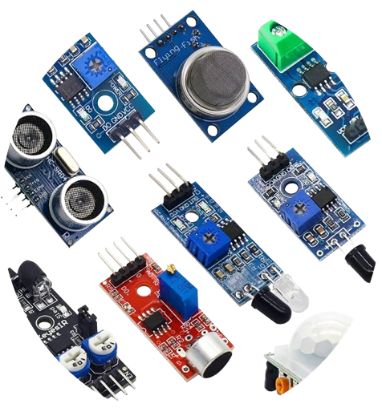
Sensors

Slide 49
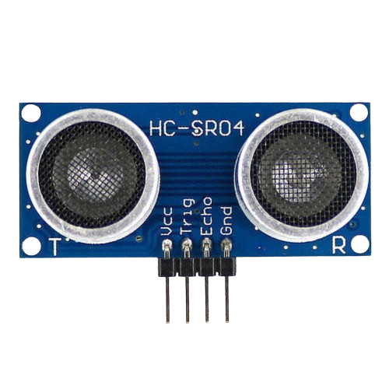
Ultrasonic Sensor
Introduction:
Definition: Ultrasonic sensors use sound waves to measure the distance between the sensor and an object.
Common Model: HC-SR04.
Working Principle:
Sound Waves: Sends out an ultrasonic wave and measures the time it takes for the echo to return.
Distance Calculation: Uses the speed of sound to calculate distance based on the time it took for the echo to return.

Slide 50
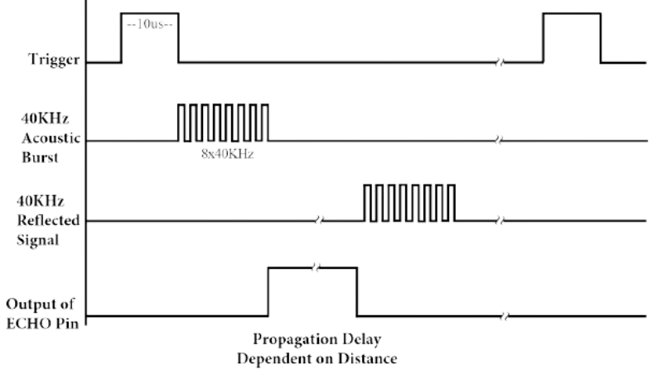
Pin Configuration
VCC: +5V Power Supply
GND: Ground
Trig: Trigger Pin
Echo: Echo Pin

Slide 51
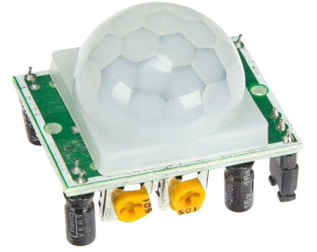
PIR (Passive Infrared) Sensor
Introduction:
Definition: PIR sensors detect motion by measuring infrared radiation from objects in their field of view.
Common Usage: Security systems, automatic lighting.
Working Principle:
Infrared Detection: Detects changes in infrared radiation, indicating movement of people or animals.

Slide 52
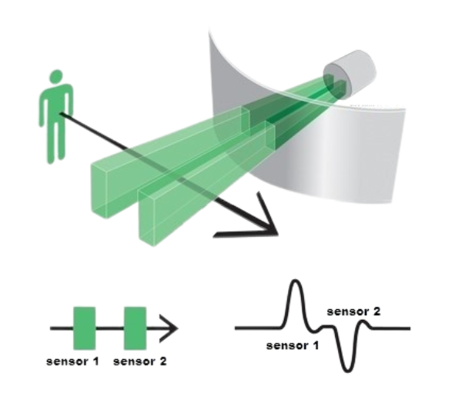
Pin Configuration
VCC: +5V Power Supply
GND: Ground
OUT: Output Signal

Slide 53
Examples for LCD & Sensors

Slide 54
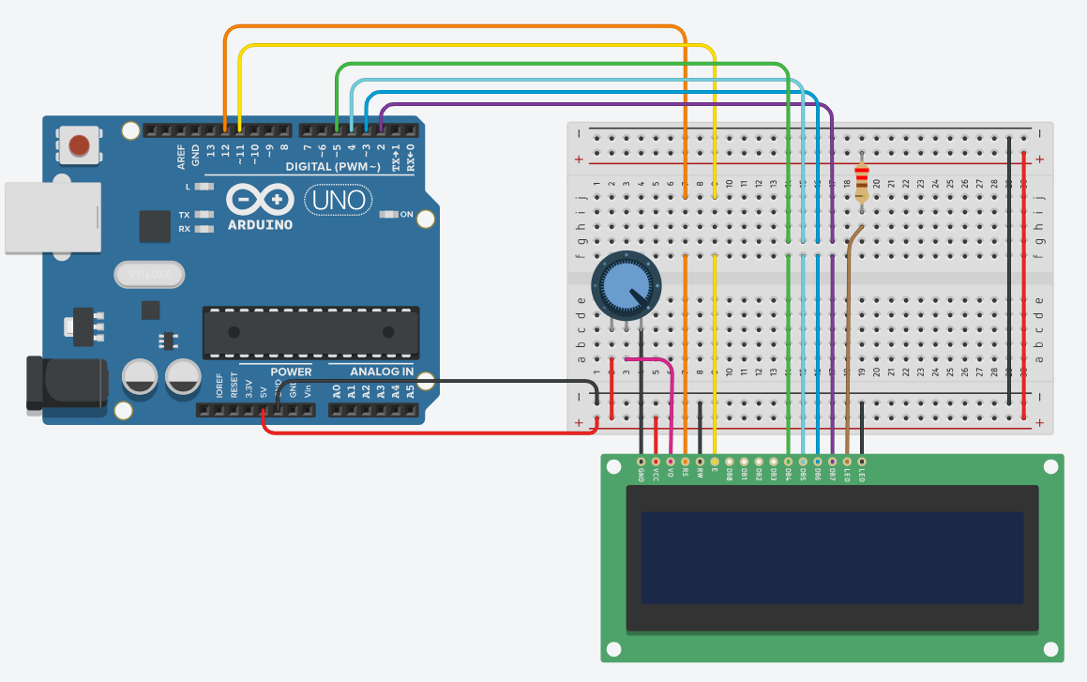
Example 9 => Print Your Name

Slide 55
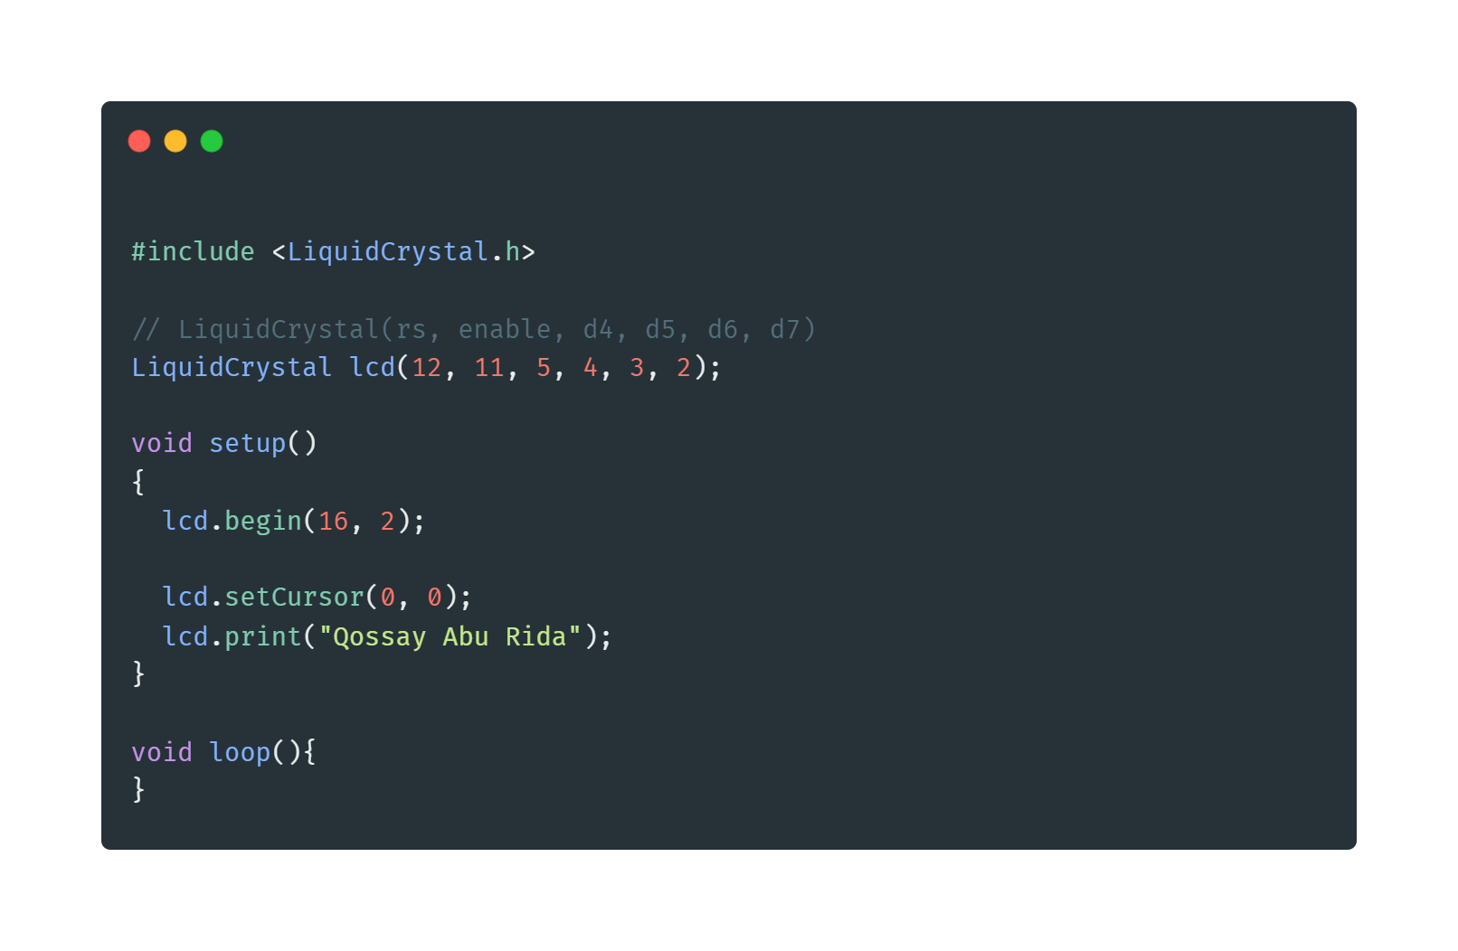
Example 9 => Print Your Name

Slide 56
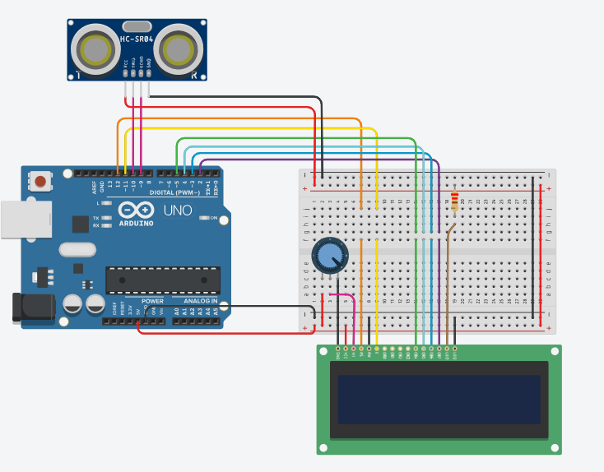
Example 10 => Distance Measurement

Slide 57
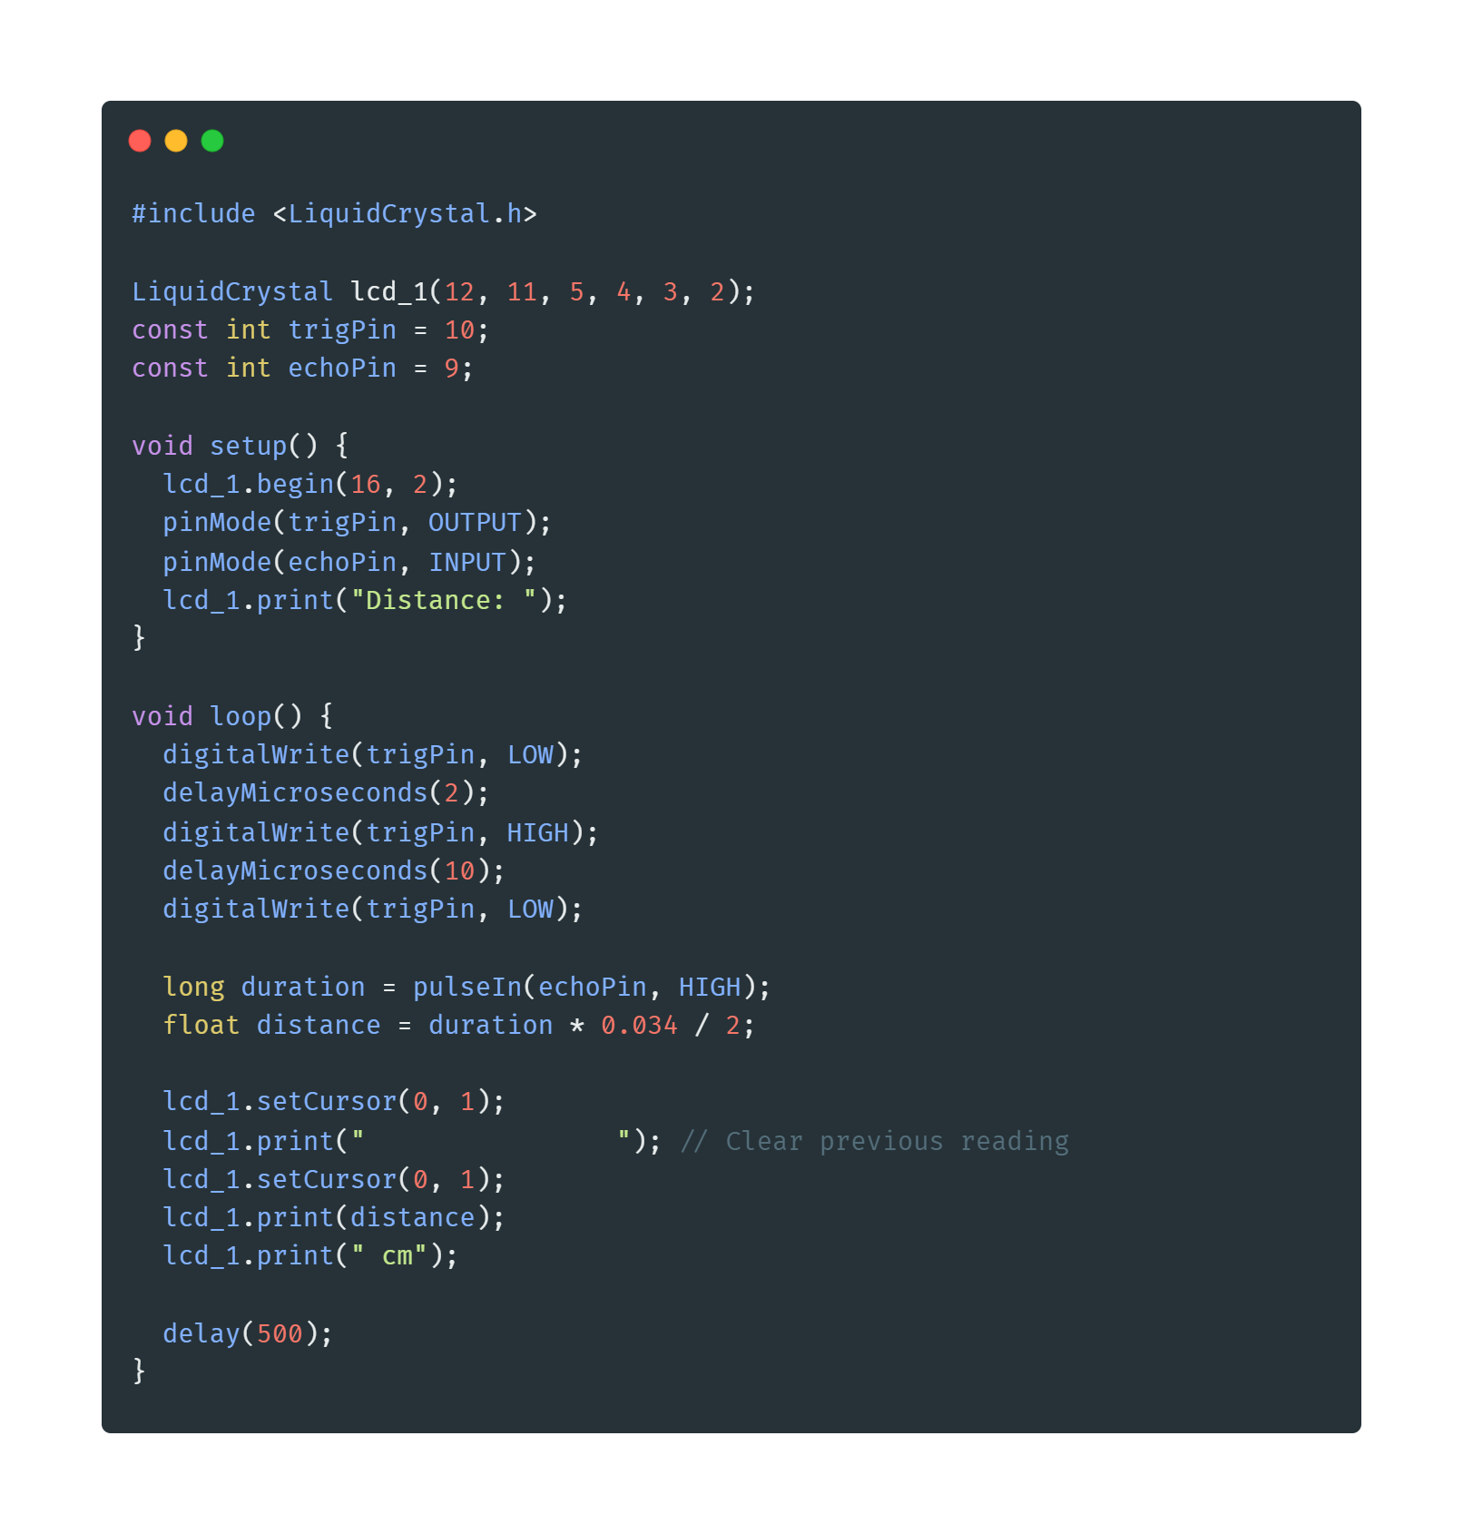
Example 10 => Distance Measurement
The speed of sound in air is approximately 343 meters per second or 0.0343 centimeters per microsecond.

Slide 58
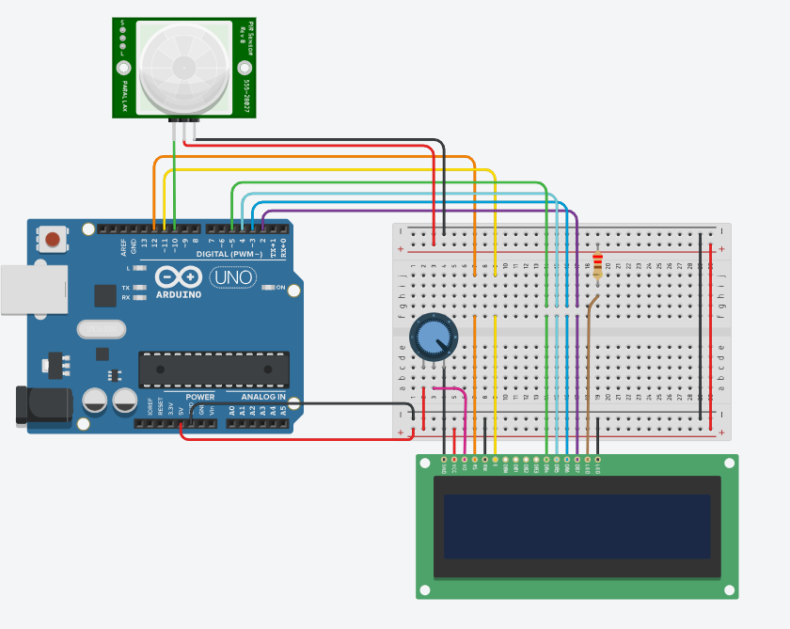
Example 11 => Motion detection

Slide 59
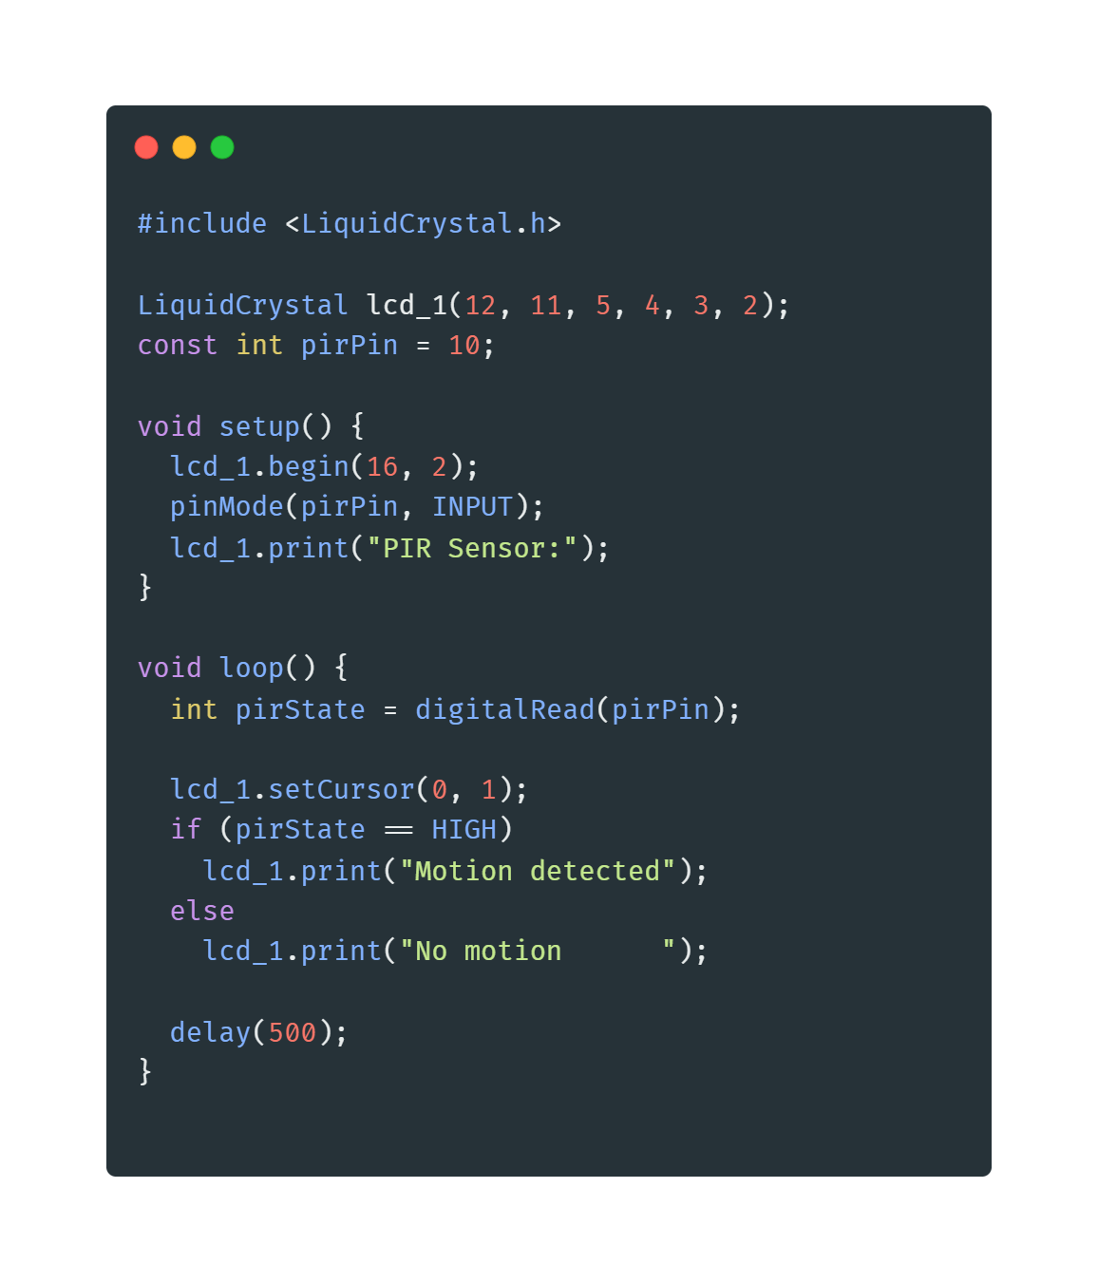
Example 11 => Motion detection

Slide 60
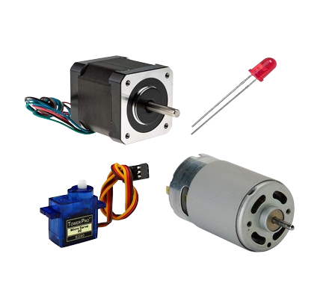
Actuators

Slide 61
Actuators
Definition: Actuators are devices that convert electrical energy into physical motion. They are used to move or control mechanisms or systems.
Common Types: Servos, DC motors, stepper motors.

Slide 62
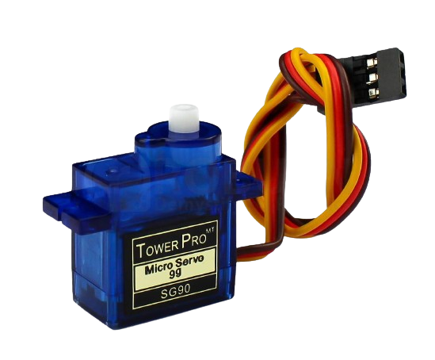
Servo Motors
Definition: Servo motors are precise control motors that use a feedback loop to control position, speed, and acceleration.
Common Use: Robotics, RC cars, controlled positioning systems.

Slide 63
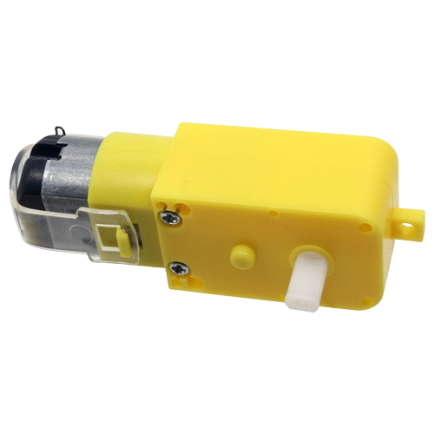
DC Motors
Definition: DC motors convert direct current electrical energy into mechanical motion.
Common Use: Fans, wheels in robots, small appliances.

Slide 64
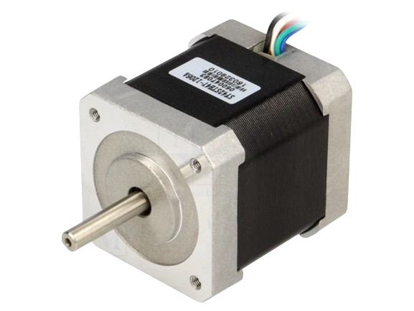
Stepper Motors
Definition: Stepper motors move in discrete steps, offering precise control over movement.
Common Use: 3D printers, CNC machines, camera platforms.

Slide 65

H-Bridge
Introduction:
Definition: An H-Bridge is an electronic circuit that enables a voltage to be applied across a load in either direction.
Common Use: Motor control, allowing motors to run forward or backward.
Working Principle:
Configuration: Consists of four switches (transistors or MOSFETs) that control the direction of current flow.
Direction Control: By closing different pairs of switches, the direction of the current and thus the motor's direction can be controlled.

Slide 66

Pin Configuration
IN1, IN2, IN3, IN4: Input pins to control the switches.
ENA, ENB: Enable pins to activate the H-Bridge channels.
OUT1, OUT2, OUT3, OUT4: Output pins connected to the motor.
VCC: Voltage supply for the H-Bridge.
GND: Ground.12V: Power supply for the motors.

Slide 67
Examples for Actuators

Slide 68

Example 12 => Servo Motors

Slide 69

Example 12 => Servo Motors

Slide 70

Example 13 => DC Motors

Slide 71

Example 13 => DC Motors

Slide 72

Example 14 => H-Bridge

Slide 73

Example 14 => H-Bridge

Slide 74

Communication

Slide 75




Contact us

